Slide 1
CSE110
Programming Language I

Slide 2
My Brief Profile
Nahian Salsabil (NNS)
Lecturer, CSE, BRACU
BSc: CSE, BUET, 2023
Email: Email: nahian.salsabil@bracu.ac.bd
Room No. UB80601
Consultation Hour:
Sunday: 11:00am - 1:30pm
Monday: 9:30am - 10:50am, 12:30pm - 1:30pm
Wednesday: 9:30am - 10:50am

Slide 3
Links
Resources: http://tiny.cc/cse110_resources_NNS
Slack: http://tiny.cc/cse110_slack

Slide 4
Outline
Tuple

Slide 5
Tuple
written in parentheses “()”
elements stored inside separated by commas
Immutable and ordered
Can be heterogeneous

Slide 6
Example

Slide 7
Immutability
Object with fixed value/ID

Slide 8
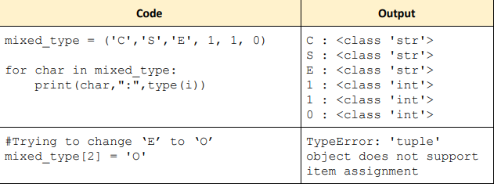
Immutability (contd)

Slide 9

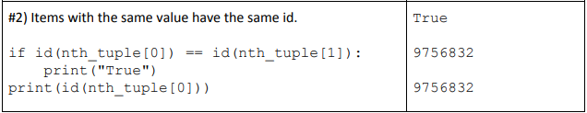
Immutability (contd)

Slide 10
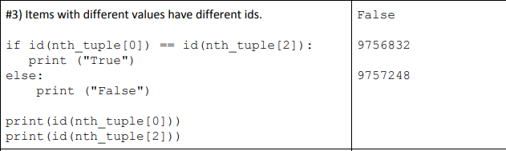
Immutability (contd)

Slide 11

Immutability (contd)

Slide 12

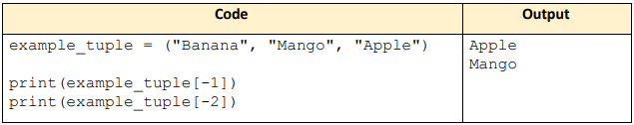
Accessing Tuple

Slide 13
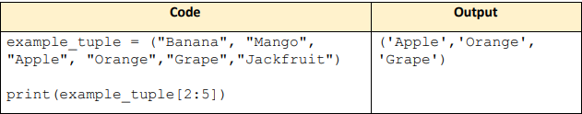
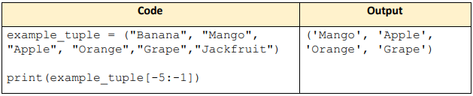
Accessing Tuple

Slide 14
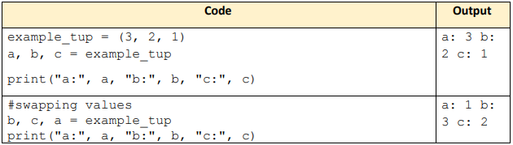
Unpacking Tuple
to store elements of a tuple in separate variables
allows to take multiple return values from a function

Slide 15
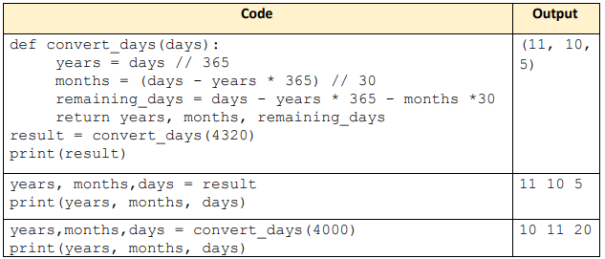
Unpacking Tuple

Slide 16
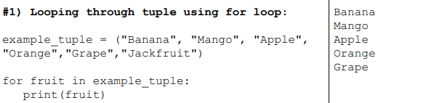
Basic Operations of Tuple
Looping through tuple using for loop

Slide 17
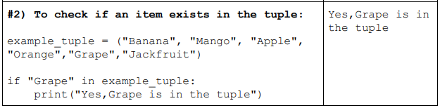
Basic Operations of Tuple
To check if an item exists in the tuple

Slide 18
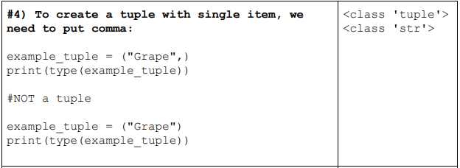
Basic Operations of Tuple
To create a tuple with single item, we need to put comma

Slide 19
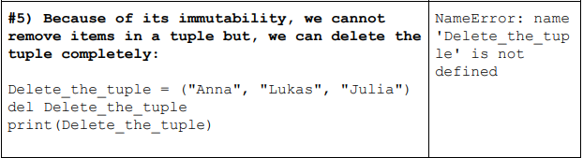
Basic Operations of Tuple
Because of its immutability, we cannot remove items in a tuple but, we can delete the tuple completely

Slide 20
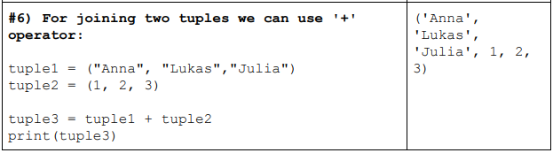
Basic Operations of Tuple
For joining two tuples we can use '+' operator

Slide 21
Methods Associated with Tuple
len()
tuple()
count()
index()
enumerate()

Slide 22
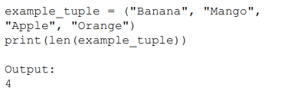
Methods Associated with Tuple
len()
Finds the number of items in the tuple

Slide 23
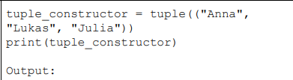

Methods Associated with Tuple
tuple()
Returns a tuple using double round-brackets.

Slide 24
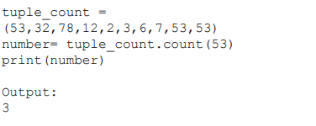
Methods Associated with Tuple
count()
Returns the number of times the value appears in the tuple.

Slide 25
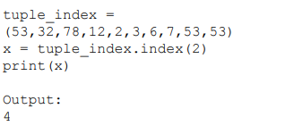
Methods Associated with Tuple
index()
Searches for the first occurrence of the value 2, and returns its position.

Slide 26
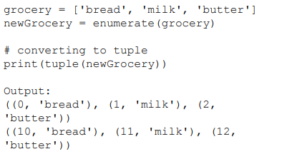
Methods Associated with Tuple
enumerate()
It takes a list as a parameter and returns a tuple for each element in the list.

Slide 27
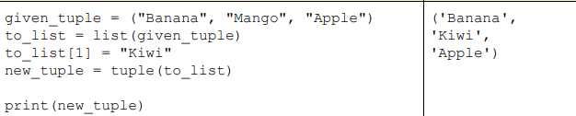
Change Tuple Values
Convert the tuple to a list
Change value in the list
Convert the list back to tuple

